Slide 1
An Introduction to
Deep Learning

Slide 2

Hello there!
I am Arshita Bhatt
Pursuing B.Tech in CSE (2017-2021)
Summer Research Intern CAI @ IIITD
Google Explore ML Facilitator

Slide 3
What is in this deck?
What is AI/ML/DL?
Glimpse of History
Building blocks of Deep learning
What will be covered in upcoming 9 days?

Slide 4
—Someone Famous
(Actually that’s from Angels and Demons)
Order out of chaos

Slide 5
1
What is AI/ML/DL?

Slide 6
What pops up in your head when you think of AI?
This?
Or
This?

Slide 7
What is AI?
Artificial Intelligence as the name implies, is the intelligence demonstrated by machines (not only robots but web apps, mobile apps too).
Unlike human intelligence which is acquired overtime, AI mimics our intelligence to get computers perform certain tasks which are either better or in equal competition with our own intelligence!
Amazing, Right?

Slide 8
Then,
What is ML | DL ?
Machine Learning (ML)
Deep Learning
(DL)
Machine learning is a specific field of AI where a system learns to find patterns in examples in order to make predictions.
Deep learning is a technique of implementing Machine Learning using the concept of “Neural network”
Order out of chaos, Rings a bell :-)

Slide 9
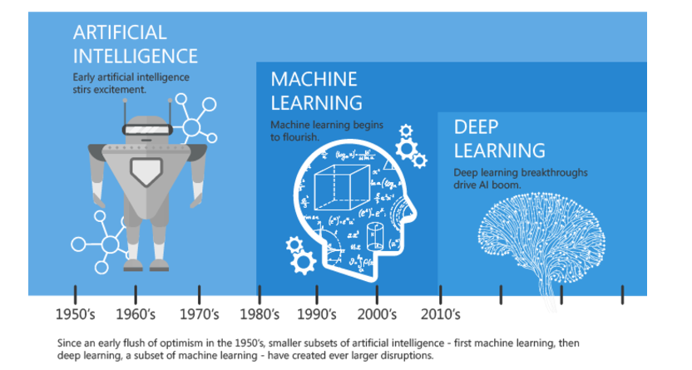

Slide 10
2
Glimpse of History

Slide 11
Timeline of Deep learning
McCulloch Pitts Neuron
Backprogation
1943
1965
1970
1989
And so on...
Birth of NN
CNN
Notes:
https://machinelearningknowledge.ai/brief-history-of-deep-learning/

Slide 12
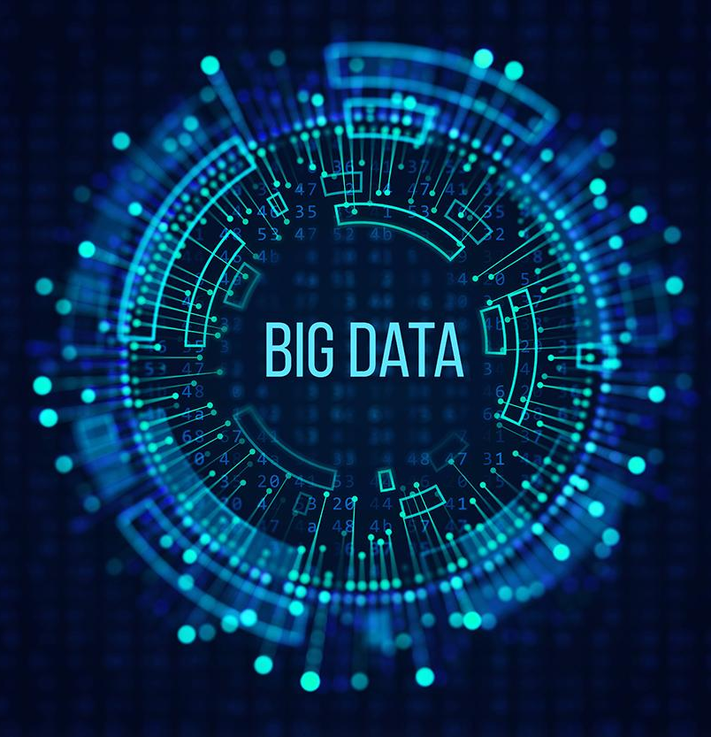
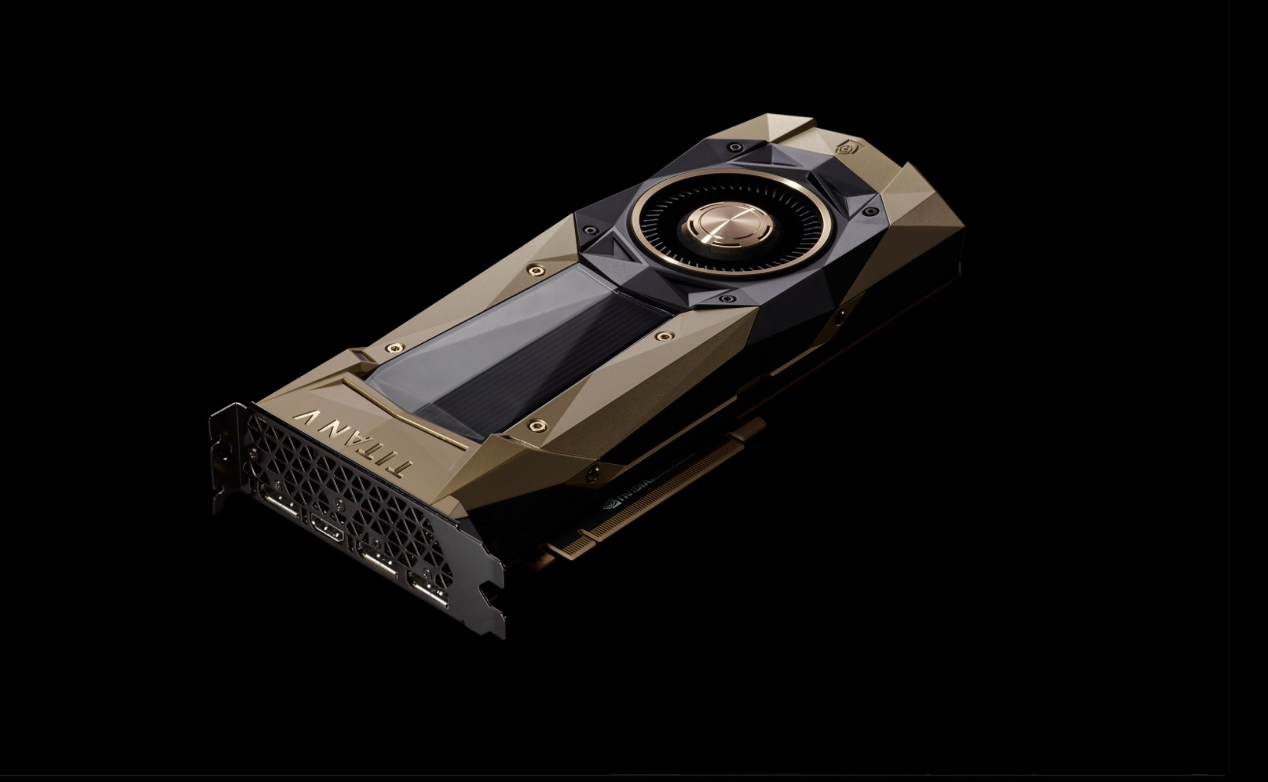

But what changed in 2010’s?
Big Data
Hardware
Open-source software
Larger Datasets
Easier collection
and storage
Era of GPU/TPU
Massively Parallelizable
New Models and Improved Techniques
Notes:
If we knew about these deep learning so long ago, then why wasn’t DL prevalant in industries back then? Why now?
What changed?

Slide 13
3
Building blocks of Deep learning

Slide 14
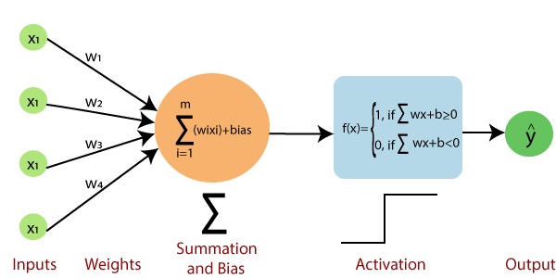
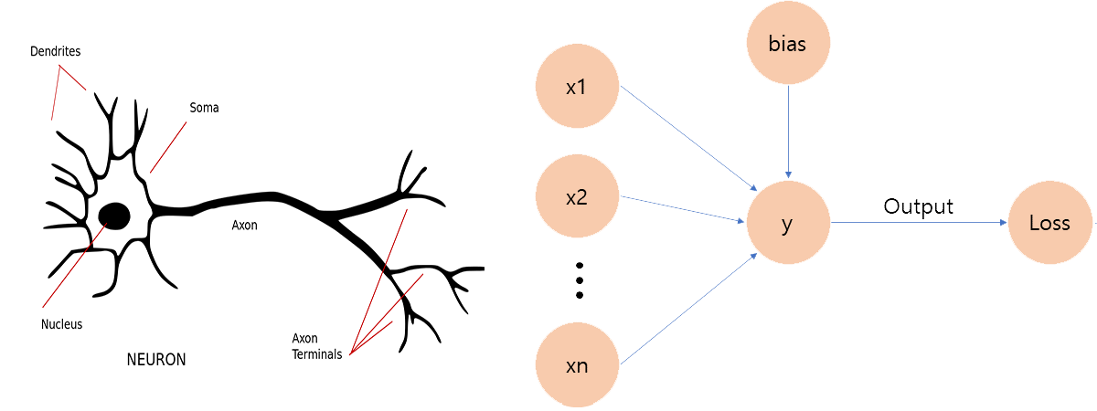
Perceptron : Cell of Deep learning

Slide 15
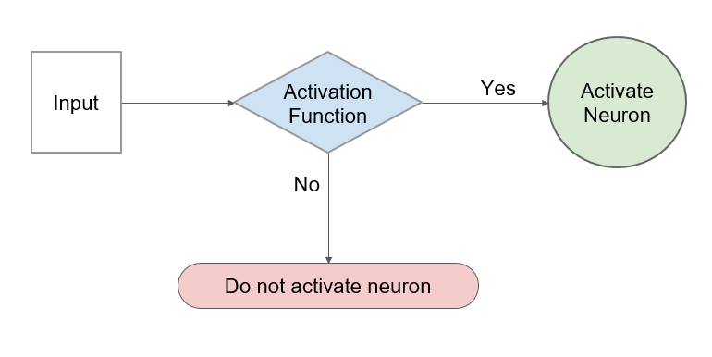
Perception of Artificial Neuron

Slide 16
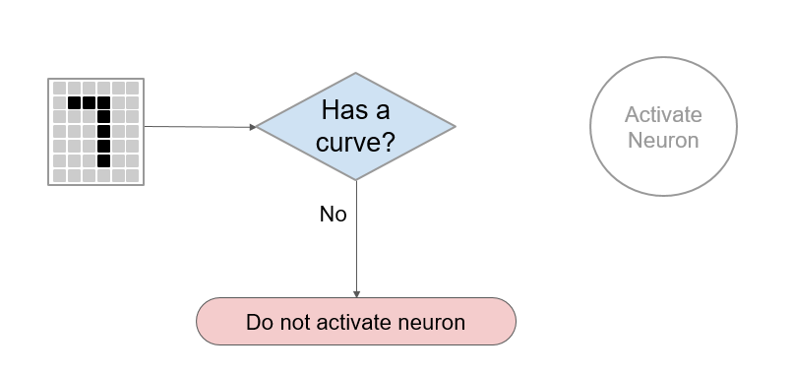
Perception of Artificial Neuron

Slide 17
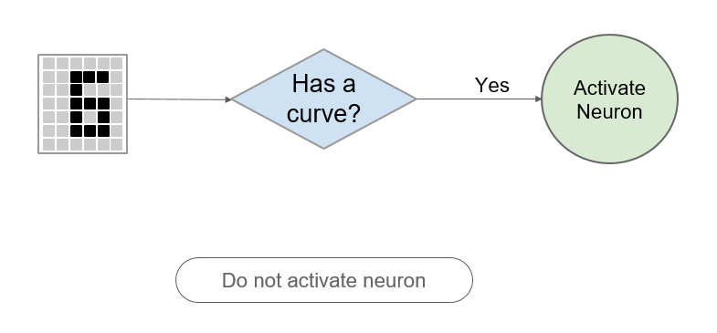
Perception of Artificial Neuron

Slide 18
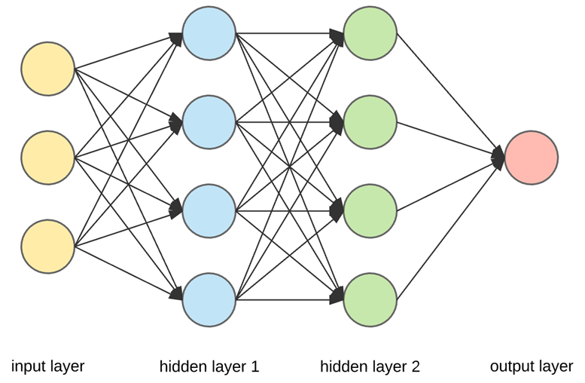
An Artificial Neural Network

Slide 19
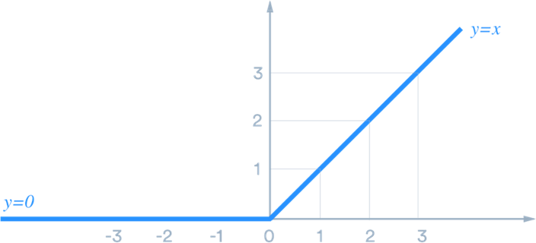
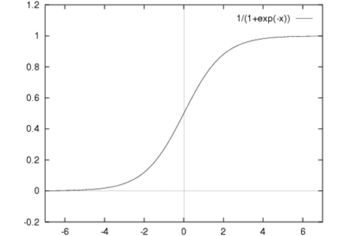
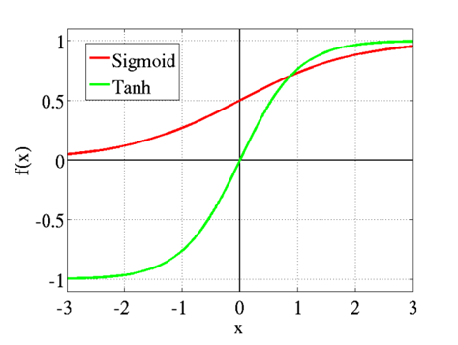
Some common Activation function
Sigmoid function
Tanh
ReLU
Notes:
Sigmoid Activation function: It is a activation function of form f(x) = 1 / 1 + exp(-x) . Its Range is between 0 and 1
ReLU stands for rectified linear unit, and is a type of activation function. Mathematically, it is defined as y = max(0, x). Its Range is 0 to x.
Tanh is also like logistic sigmoid but better. The range of the tanh function is from (-1 to 1). tanh is also sigmoidal (s - shaped).

Slide 20
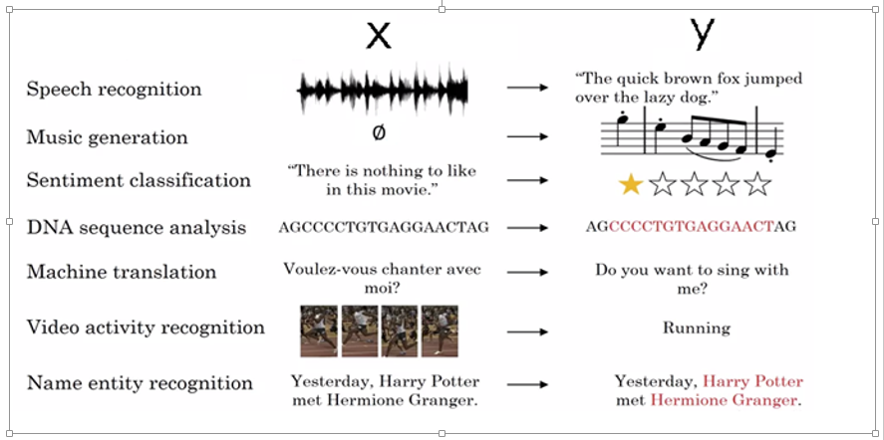
Some Interesting Example that uses DL (extensively)

Slide 21
4
What will be covered in upcoming 9 days?
Notes:
Links included in slide

Slide 22
1
Content to be covered
2
3
Image Classification
Introduction to Fast.ai and Image classification hands-on
CNN and working
Mathematical intuition of CNN, Overfitting
/Underfitting
Image Segmentation
Image segmentation and types, SOTA Algos

Slide 23
4
Content to be covered
5
6
Object Detection
Object detection systems, it’s types. AUC/ROC
Introduction to NLP
Why NLP is important,
Sentiment analysis, RNN etc
LSTMs and GRU
Neural Machine Translation, BERT, Encoders etc

Slide 24
7
Content to be covered
8
9
Meme Saheb
Project walkthrough of Meme saheb-generating memes!
Transformers
Seq2Seq models. Attention, Transformers from scratch
PyCaret
Special session by Moez Ali (Creator - PyCaret)

Slide 25


Slide 26
So, Let’s hop in
to image classification

